Slide 1
Introduction To Online Learning
Course Title: Programming Language II Course Code: CSE 111 Semester: Summer 2020

Slide 2
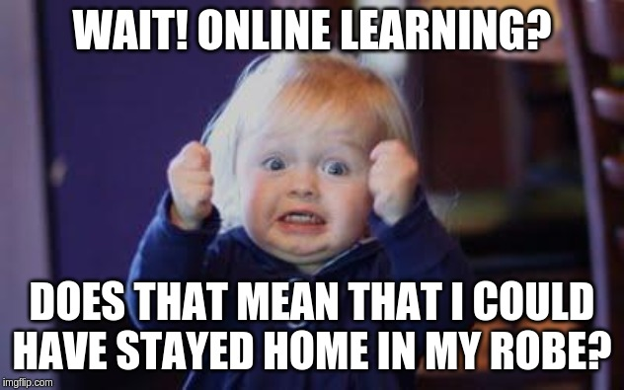
Online Learning
Online learning is when you do courses online instead of in a physical classroom.
The biggest difference between online and face-to-face learning is that in online learning students can study from anywhere, at any time and at their own pace.
Through online, you can get the education you want, from anywhere in the world.
You can set your own schedule to learn: study in the early morning, on your lunch break or even the middle of the night.
No more lecture missing problem. Tutorials and lecture videos will always be available online.

Slide 3
Contents of Online Learning
Main Lecture Videos : Viewable outside the class time from buX table of contents and the medium of instruction will be English.
Pop quiz: Short elementary quizzes will accompany each topic to maintain student engagement with course materials.
Assignments: Suitable sets of assignments will be provided every week.
Supplementary:
Scribe: Notes following the main lectures.
Bengali videos: An overview of the main lectures
Lecture Slides

Slide 4
Mark Distribution (Tentative)
Quiz | 20%
Mid | 20%
Final | 20%
Assignment | 30%
Project | 10%
Total | 100%

Slide 5
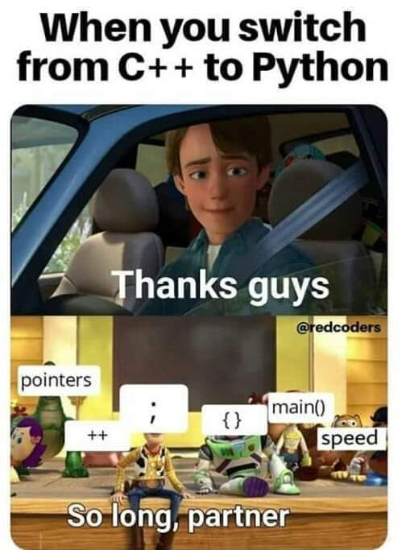
About CSE111
JAVA
Course Title: Programming language II
Programming Language: Python
IDE: Spyder, Jupyter Notebook (Anaconda)
The course will focus on programming, in particular the object-oriented programming paradigm in Python.
Topics include primitives, expressions, assignments, functions, basic features of OOP: Encapsulation, Inheritance, Polymorphism and Abstraction.
Scanners
Sop()

Slide 6
Referred Books
Title | Writer | Edition | ISBN-13
Introduction to Computation and Programming using Python | John V. Guttag | 2nd | 978-0262529624
Python Crash Course: A Hands-On, Project-Based Introduction to Programming | Eric Matthes | 2nd | 9781593279288
Automate the Boring Stuff with Python: Practical Programming for Total Beginners | Al Sweigart | 1st | 978-1593275990

Slide 7


